Slide 1
Microsoft
Excel
Debug
Shala

Slide 2
History of Advanced Excel
Debug
Shala

Slide 3

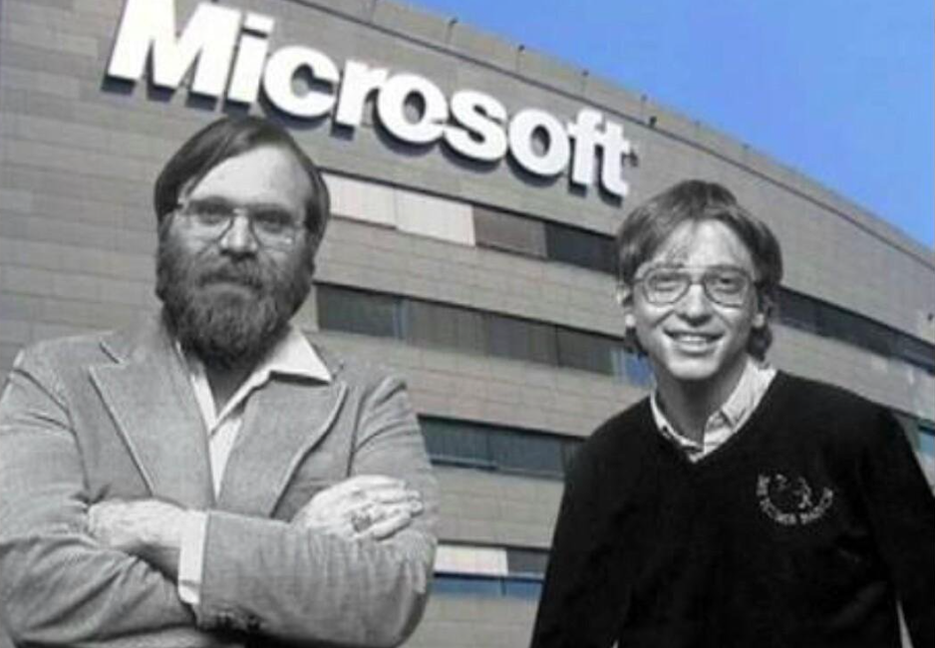
Apr,4 1975
Debug
Shala

Slide 4
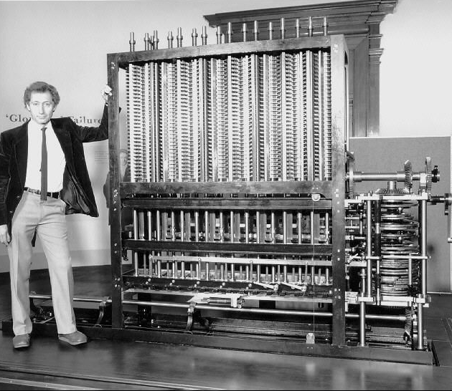
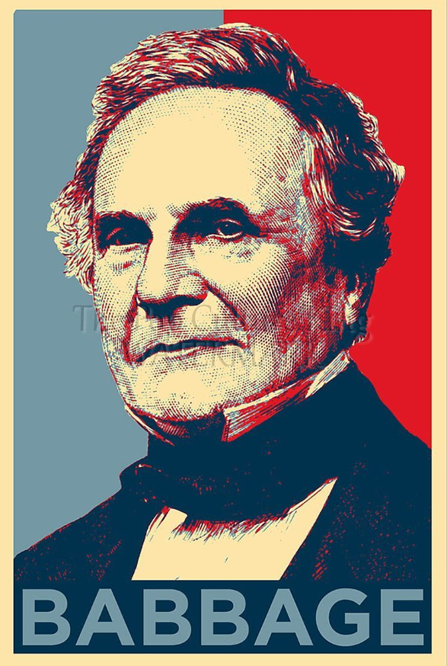
Debug
Shala

Slide 5
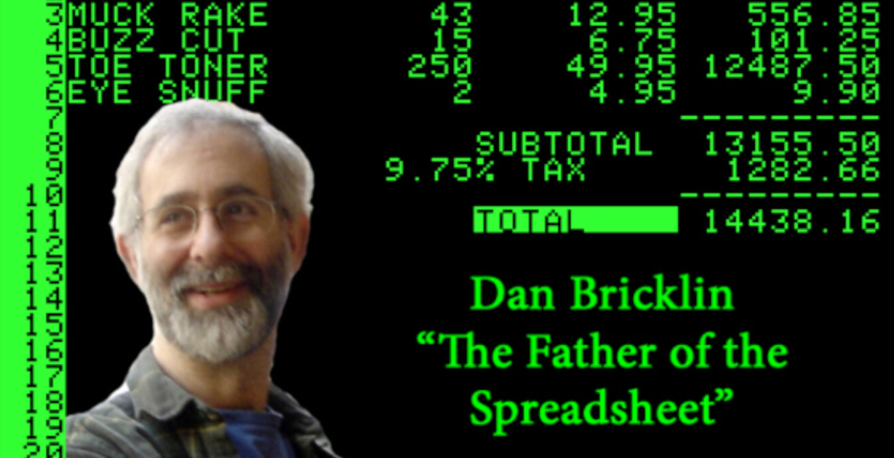
Debug
Shala

Slide 6
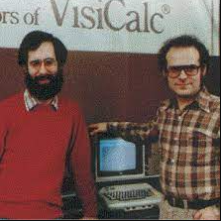
Bob Frankston
Dan Bricklin
VISICALC ---The First Spreadsheet Program
Debug
Shala

Slide 7
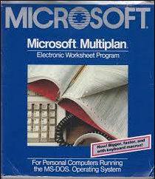
Debug
Shala

Slide 8
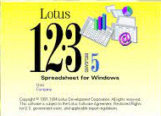
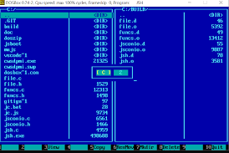

Lotus Software
Debug
Shala

Slide 9
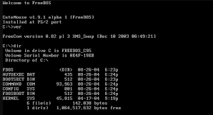
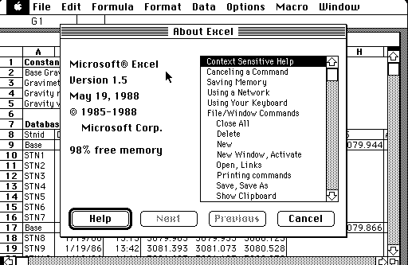

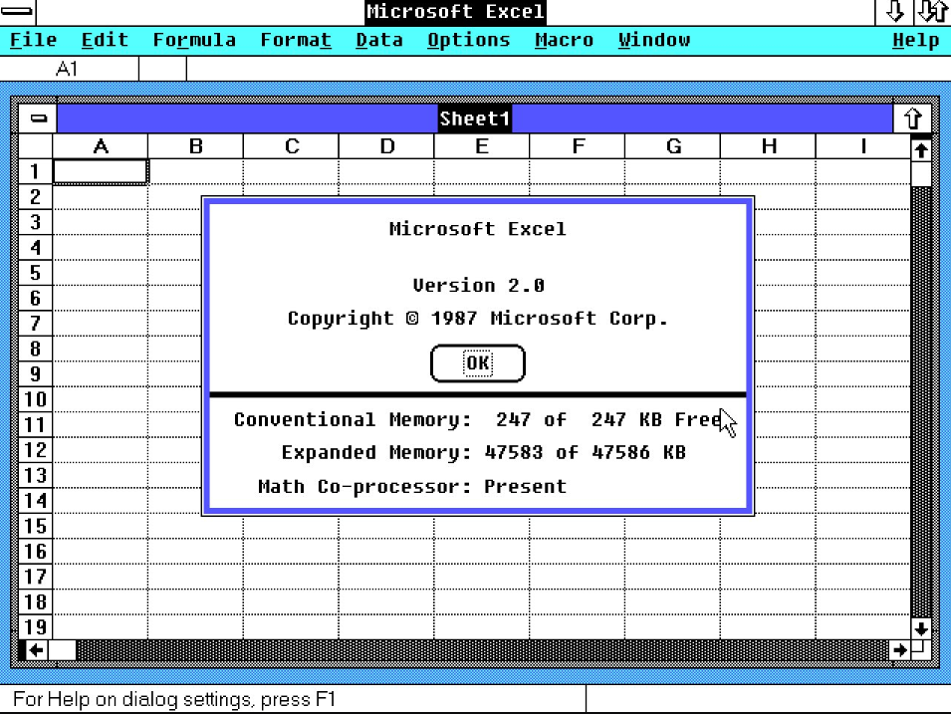
Upgradation of Multiplan
Command Line Interface
GUI
R– 16384
C- 256
Debug
Shala

Slide 10
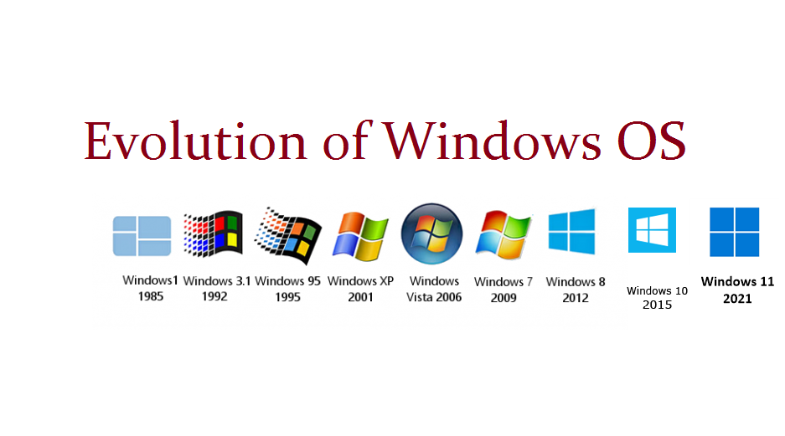
Debug
Shala

Slide 11
AND many more updates of excel………!
Version | Year | Tools Added
2nd | 1987 | Menu Options
3rd | 1990 | Tool Bar
4th | 1992 | Charts
5th | 1993 | VBA
….. | 2007 | Ribbon , R-1048576,C-16384
 | 2010 | Pivot Table
 | 2016 | Forecast Feature
 | 2019 | Powe Query Editor
 | 2021 | Collaboration
Debug
Shala

Slide 12

Debug
Shala

